Slide 2

Problem
Scrabble-Steine anzeigen

Slide 3
jMonkeyEngine
A cross-platform game engine for adventurous Java developers.

Slide 4
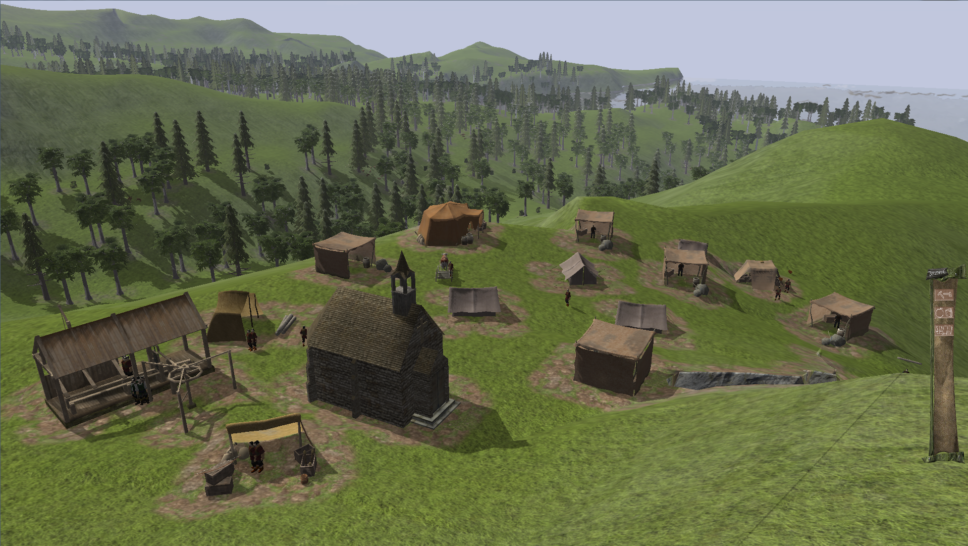

Slide 5
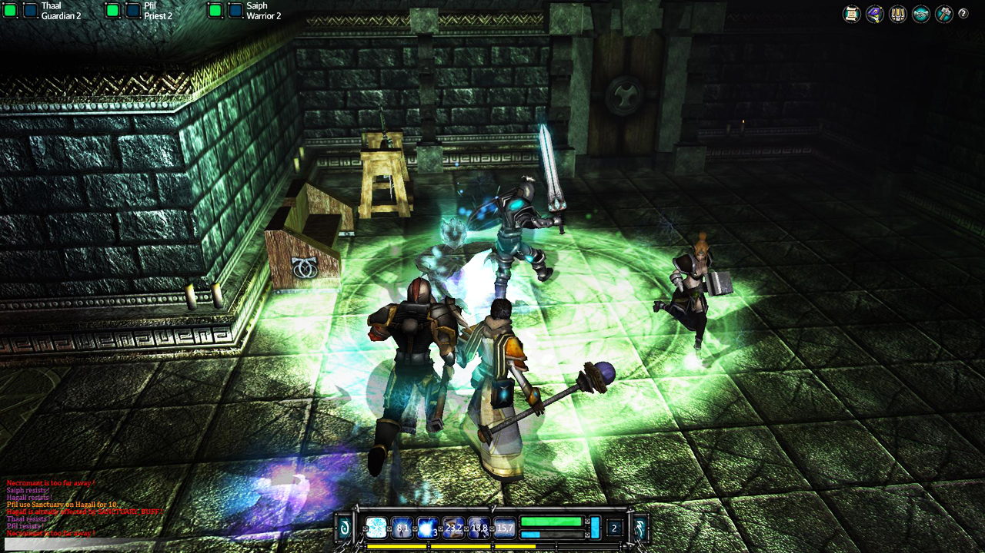

Slide 6
jMonkeyEngine
Cross-platform game engine
→ Game Loop
→ Scene
→ Models
→ Textures
→ Cameras
→ Light
Nutzen in AR Scrabble:
Anzeigen von Steinen auf dem Scrabble Board

Slide 7
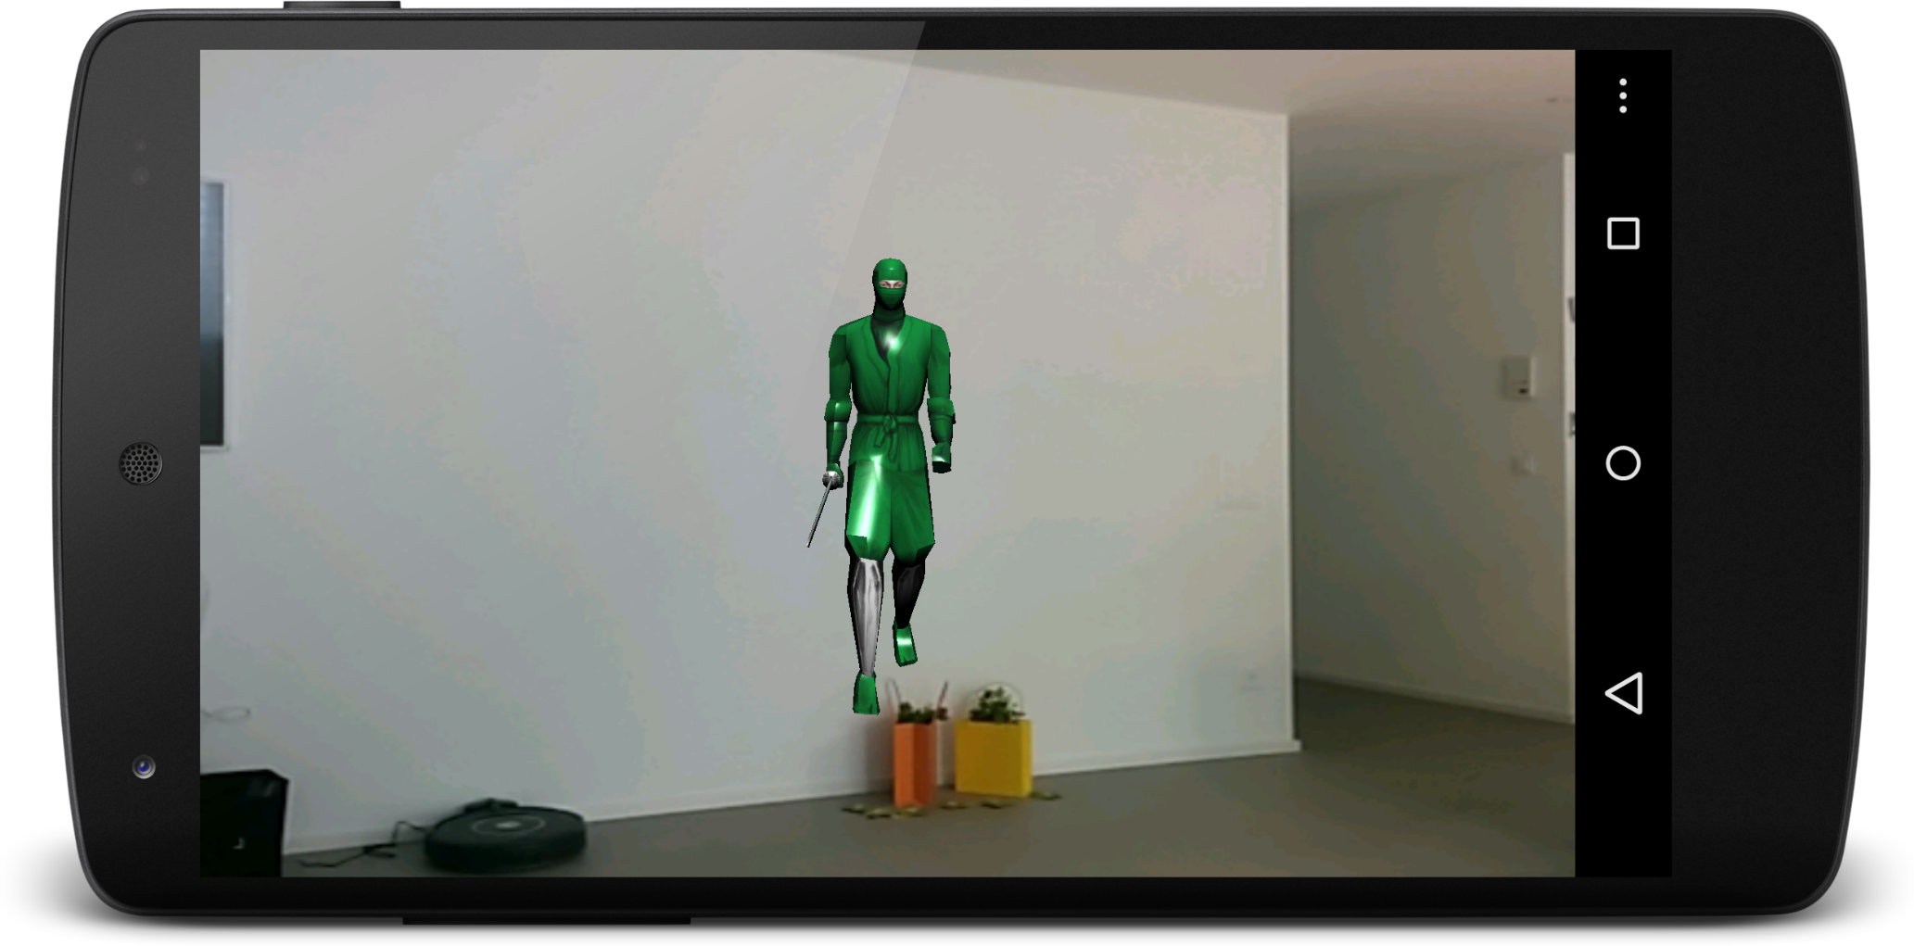
Step 1: Run jMonkey samples

Slide 8
Step 2: Create stone models / textures
Süess?

Slide 9
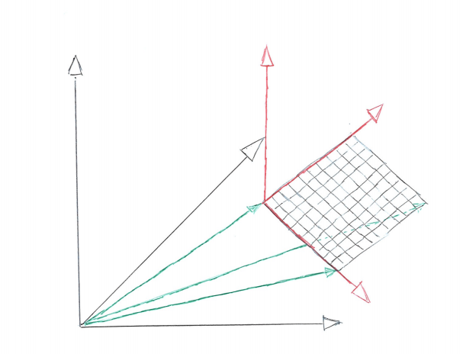
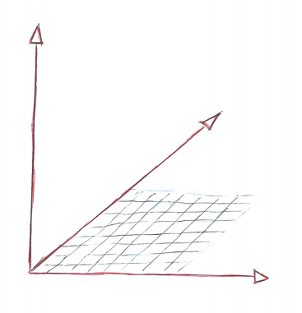
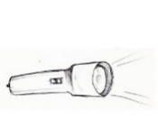

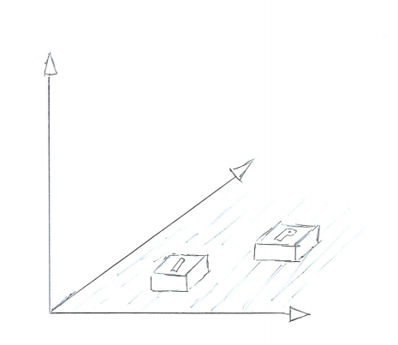

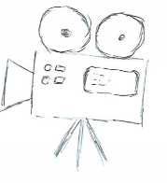
Step 3: Connect jMonkey/Vuforia Worlds
jMonkey
Vuforia
Vuforia Target
Pose Matrix

Slide 10
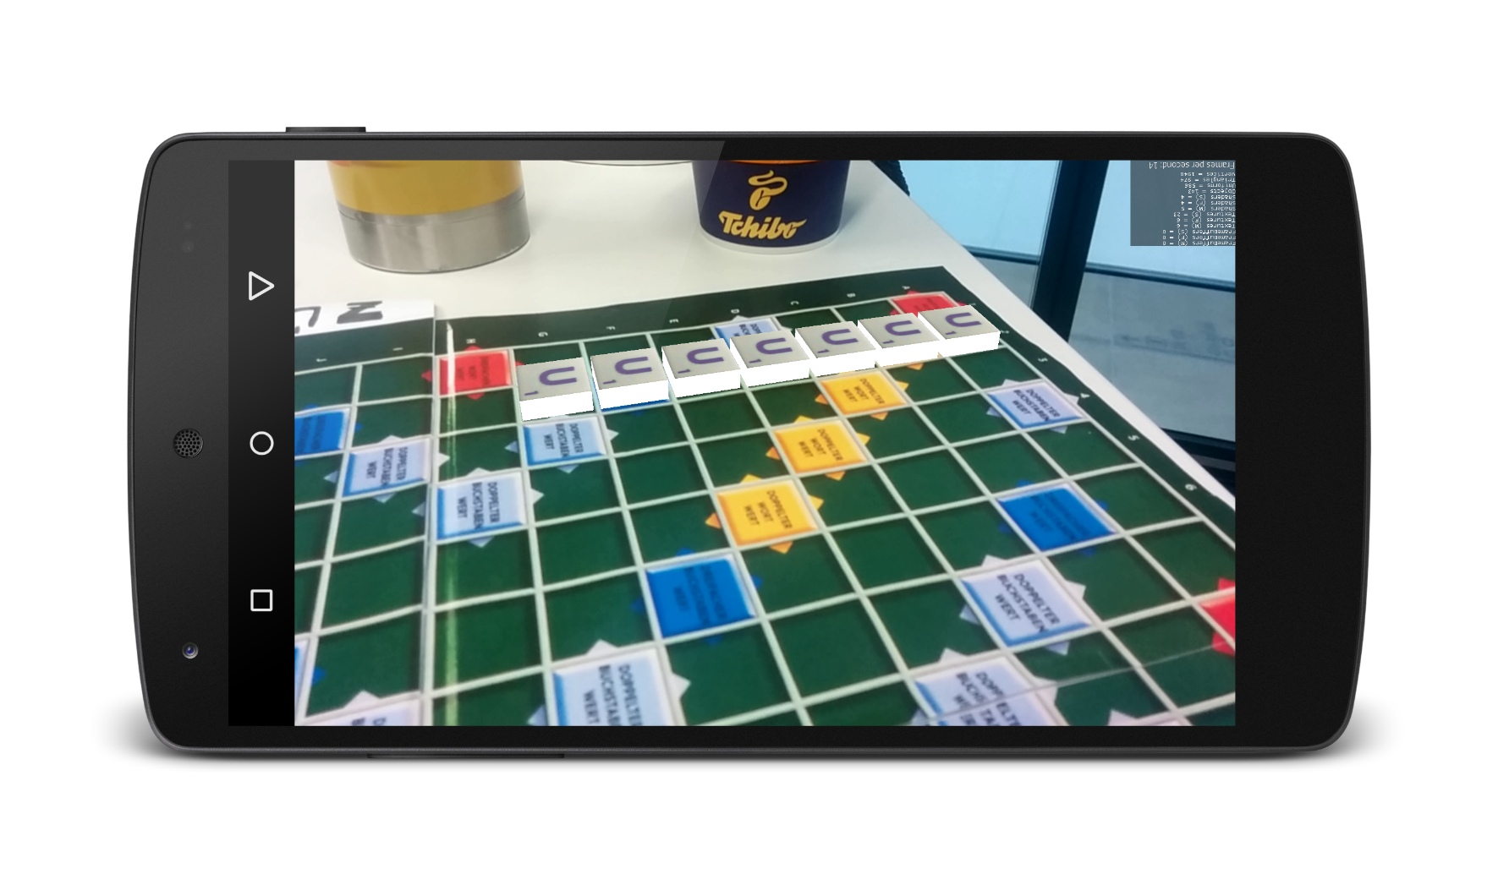
Resultat

